Slide 1
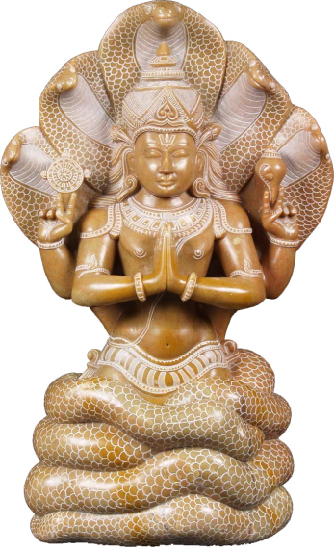
ASHTANGA YOGA OF MAHARISHI PATANJALI

Slide 2
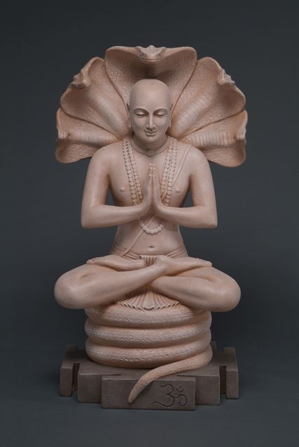
MAHARISHI PATANJALI
Maharishi Patanjali is thought to be the incarnation of Adisesha.
He lived between 500BC and 400AD.
It is said that Sage Patanjali gave yoga for purification of mind, grammar for clarity of speech and medicine for removing impurities of body.
In his works on yoga, he gave 196 Yoga sutras which is popularly known as Patanjali Yoga Sutras, in 4 padas.
They are – Samadhi pada (51), Sadhana pada (55), Vibhuthi pada (56) & Kaivalya pada (34)
This forms the base of yoga.
In this he has spoken about ASHTANGA YOGA in Sadhana pada and Kaivalya pada.

Slide 3
ASHTANGA YOGA
“Yamaniyamasanapranayamapratyaharadharanadhyanasamadhyoashtavangani”

Slide 4
8 Limbs of yoga
1.Yama
(Self-Restraints)
2.Niyama
(Observances)
3.Asana
(Yoga postures)
8.Samadhi
(Salvation)
4.Pranayama
(Control over breath)
5.Pratyahara
(Withdrawal of mind from senses)
6.Dharana
(Concentration)
7.Dhyana
(Meditation)

Slide 5
ASHTANGA YOGA
The Ashtanga yoga (8 Limbs of Yoga) has been classified into 2 parts
Bahiranga yoga
Antharanga yoga
Bahiranga yoga (External Aspects)
Yama
Niyama
Asana
Pranayama
Pratyahara
Antharanga yoga
Dharana
Dhyana
Samadhi

Slide 6
BAHIRANGA YOGA

Slide 7
YAMA
“Ahimsasatyasteyabrahmacaryaparigraha yamaha”
Yamas are the Rules of conducts / self-restraints that must be followed by a yoga practitioner . They are
Ahimsa : Non-voilence
Satya : Truthfulness
Asteya : Non-Stealing
Brahmacharya : Continence
Aparigraha : Non-possession

Slide 8
NIYAMA
“Shouchasantoshatapasvadhyayeshvarapranidhanani niyamah”
These are the observances or principles of Morality, a yoga practitioner must practice
Shoucha : Internal &External Cleanliness
Santosha : Contentment
Tapa : Austerity
Svadhyaya : Self-study
Ishwarapranidhana : Worship of God

Slide 9
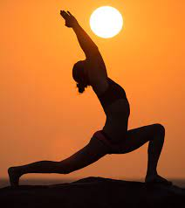
ASANA (Posture)
“Sthirasukham asanam”
Posture is that which is firm & pleasant.
By effort and meditating on ultimate, posture becomes firm & pleasant.
This removes the duality of mind.

Slide 10
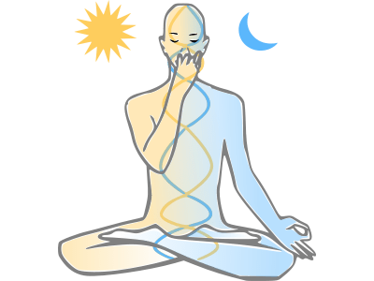
PRANAYAMA (Control over Breathing)
“Tasmin sati shvasaprashvasayorgativichchedah pranayamaha”
Controlling the motions of inhalation & exhalation is called pranayama.
By this covering over the brightness of inner light is dissolved.
This prepares the person for dharana.

Slide 11

PRATYAHARA (Withdrawal of mind from senses)
“Svavishayasamprayoge chittasvarupanukara iendriyanam pratyaharah”
Pratyahara is a stage at which the sensory organs consciously do not have any contact with the external organ and appears one with the mind
This leads to mastery over the senses.

Slide 12
ANTHARANGA YOGA

Slide 13
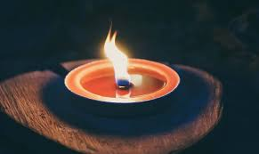
DHARANA
“Deshabandhachittasya dharana”
Dharana is hplding the mind to particular object.

Slide 14
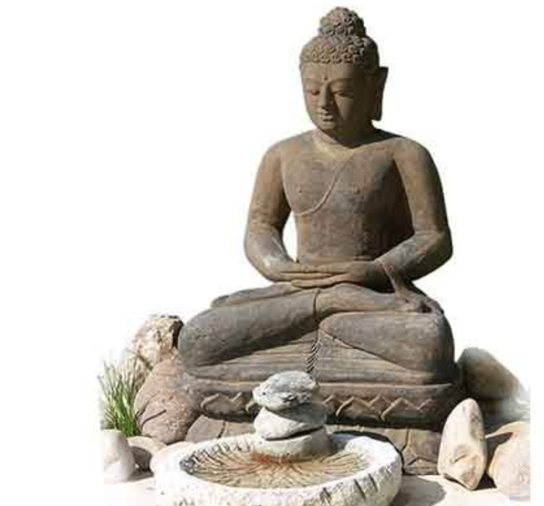
DHYANA
“Tatra pratyayaikatanata dhyanam ”
An unbroken flow of thoughts towards the object being concentrated is dhyana.

Slide 15
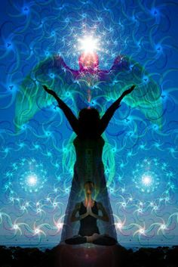
SAMADHI
“Tad evarthamatranirbhasam svaroopashoonyam iva samadhih”
Samadhi is a state at which the mind gives up the mind all forms & reflects only the meaning of the object of dhyana.

Slide 16
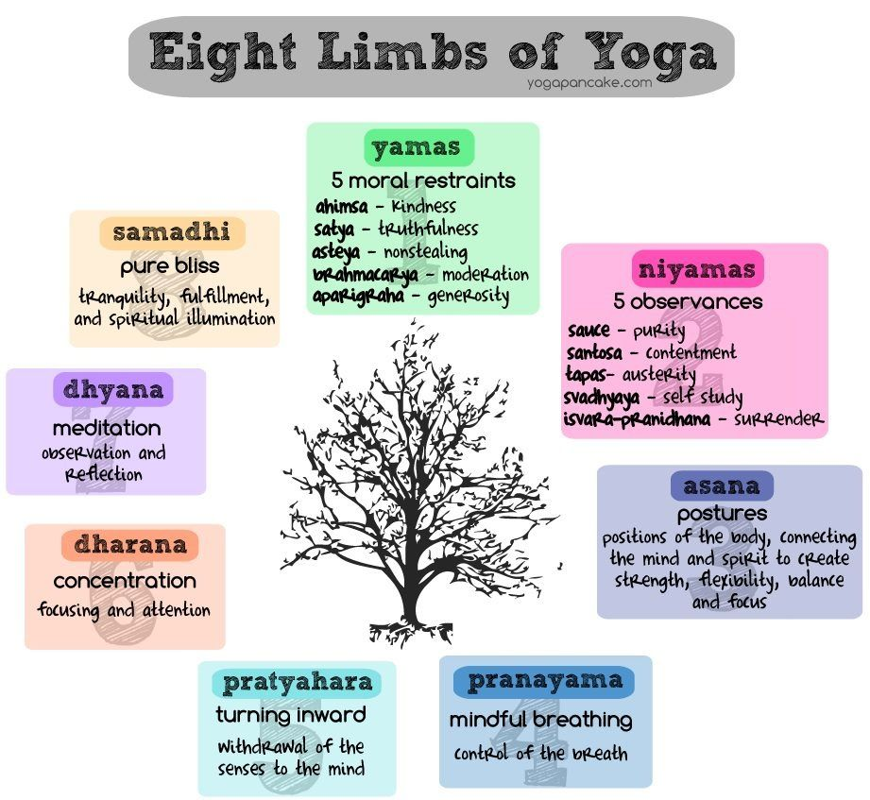

Slide 17


